Slide 1
WID3009 ACTIVITY 3 :HEURISTIC ANALYSIS
NAME:KUGANESWARAN LETSHIMANAN
MATRIC ID:WID170021 (17107141/1)
LECTURER :PROF DR.LOO CHU KIONG

Slide 2
CODES
if game.is_loser(player):
return float('-inf')
if game.is_winner(player):
return float('inf')
blanks = game.get_blank_spaces()
blanks_n = len(blanks)
max_blanks = game.width * game.height
# Beginning game & Middle game.
if blanks_n > max_blanks * 0.1:
return custom_score_2(game, player)
# End game.
else:
my_tree = get_tree(game, player)
opp_tree = get_tree(game, game.get_opponent(player))
return float(len(my_tree) - len(opp_tree))

Slide 3
FUNCTIONS
For the first 80% of the game—determined by the number of blank spaces on the board—this heuristic tries all available moves and then tries all the available moves 1-ply ahead, forming a tree with a depth of max 3. The heuristic does this for the agent’s perspective and the opponents, counting the number of the agent own respective moves and subtracting the number of opponents moves, which are the nodes of the search tree.
For the last 20% of the game this heuristic takes the same idea, but as far as it can. Instead of just going 1-ply ahead, it performs a depth first search and finds all possible leaf nodes at varies depths. And again, like the prior, it sums up the agents moves and sums up its opponents and subtracts the two totals for the score.
The rationale behind this heuristic is that counting the number of immediate available moves works relatively well. Therefore, knowing the number of moves 1-ply ahead shouldn’t hurt, especially if the complexity of doing so isn’t too terrible in practice. This rational for the last 20% is the same, but with the added assumption that the branching factor is low enough by this point of the game, that the overall complexity would remain within a reasonable margin.

Slide 4
BENEFITS
Improves on that by counting a 1 ply further than moving 1 to 2 ply ahead .
Two times more complex than improved score.Providing more iterations of Iterative Deepening, thus more search depth
The branching factor would have reduced by quite abit,thusproved to benot so time consuming.

Slide 5
RESULT VS OTHER AGENTS
*********************
Evaluating: WID170021_Implementation
*********************
Playing Matches:
----------
Match 1: WID170021_Implementation vs Random Result: 68 to 12
Match 2: WID170021_Implementation vs MM_Null Result: 63 to 17
Match 3: WID170021_Implementation vs MM_Open Result: 49 to 31
Match 4: WID170021_Implementation vs MM_Improved Result: 43 to 37
Match 5: WID170021_Implementation vs AB_Null Result: 54 to 26
Match 6: WID170021_Implementation vs AB_Open Result: 50 to 30
Match 7: WID170021_Implementation vs AB_Improved Result: 49 to 31
Results:
----------
WID170021_Implementation 67.14%

Slide 6
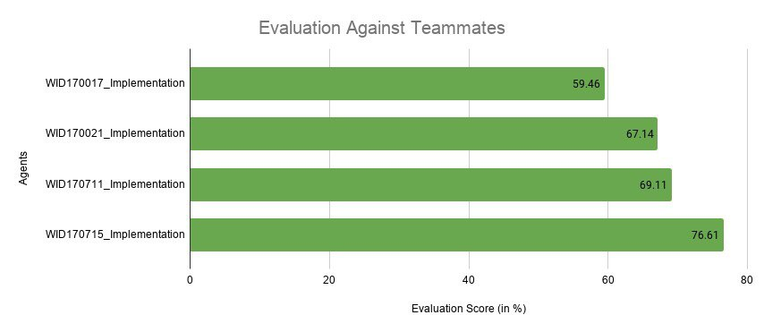
COMPARING WITH TEAMMATES

Slide 7
THANK YOU

